Slide 1
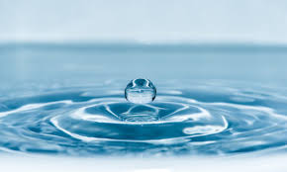
FLUID MEASUREMENT ultrasonic type

Slide 2
fluid
In physics, a fluid is a liquid that under an applied shear stress, or external force, continuously deforms (flows). Fluids, including liquids, gases and plasmas, are a phase of matter.

Slide 3
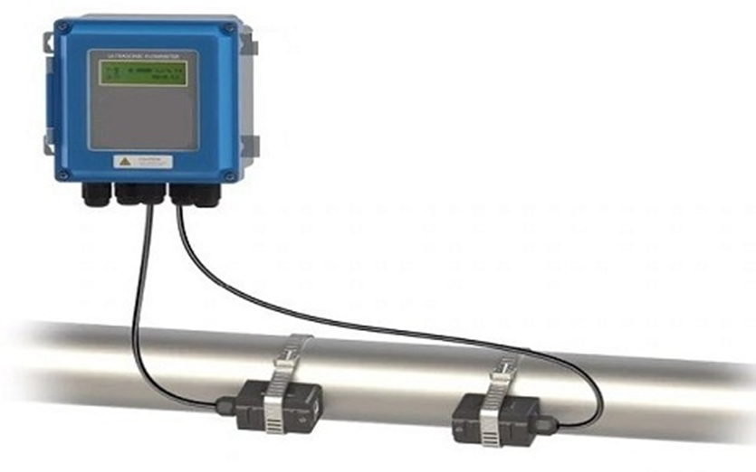
ULTRASONIC FLOW METER
An ultrasonic flow meter can be defined as, a meter that is used to measure liquid velocity with ultrasound to analyze the volume of liquid flow.
This is also called volumetric flow meter because this is used to find the volume of a liquid.
This is a volumetric flow meter in the liquid flow that requires bubble particles or minute particles.

Slide 4
Continue….
In wastewater applications, these meters are acceptable, but they would not work for drinking/distilling water. This form of flow meter is therefore suitable for applications where chemical compatibility, low maintenance and low-pressure drops are desired.
These meters will affect the audio properties of the liquid and also impact through viscosity, density, temperature, etc.

Slide 5
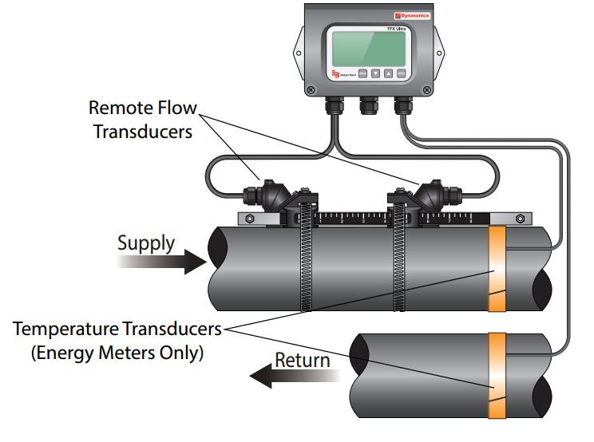
Working principle:
Using upstream and downstream transducers, sensor tubing, and reflector, an ultrasonic flow meter construction can be achieved. The working theory of the ultrasonic flow meter is that the motion of a liquid inside a pipe is resolved using sound waves.

Slide 6
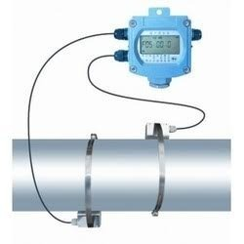
Continue…
Whenever the liquid flows in the pipe quickly, then the frequency shift can be increased linearly. The transmitter processes the signals from the wave & its reflections determine the flow rate. Transit time meters transmit & receive ultrasonic waves in both the directions within the pipe. At no-flow condition, the time taken to flow in between upstream & downstream in between the transducers is the same.
Under these two flowing conditions, the wave at upstream will flow with less speed than the downstream wave. As the liquid flows faster, the distinction between the up & downstream times raises. The times of the upstream & downstream processed by the transmitter to decide the flow rate.

Slide 7
Advantages:
The advantages are:
It does not block the path of liquid flow.
The o/p of this meter is different for density, viscosity & temperature of the liquid.
The flow of liquid is bidirectional.
Conservation of energy
It is appropriate for huge quality flow measurement
It is handy to fit and maintain.

Slide 8
Disadvantages:
The disadvantages are:
It is expensive as compared with other mechanical flow meters.
Design of this meter is complex
Auditory parts of this meter are expensive.
These meters are complicated as compared with other meters; thus, it requires specialists for maintaining and repairing these meters.
It doesn’t work once the pipe contains holes or bubbles in it.

Slide 9
Applications:
The applications of ultrasonic flow meters include the following:
These meters are used in wastewater and dirty liquid applications
These meters are used wherever chemical compatibility, less maintenance, and low-pressure drop are required.
These meters are used to measure the velocity of a liquid through ultrasound to analyze volume flow.
This is one kind of device for volumetric flow measurement for liquids as well as gases.

Slide 10


